Slide 1
OpenModelica Eclipse Plugin and
MetaModelica Exercises
Adrian Pop
adrian.pop@liu.se
PELAB/IDA/LIU, 2007-03-29
Updated 2010-11-03
by Peter Fritzson and Martin Sjölund

Slide 2
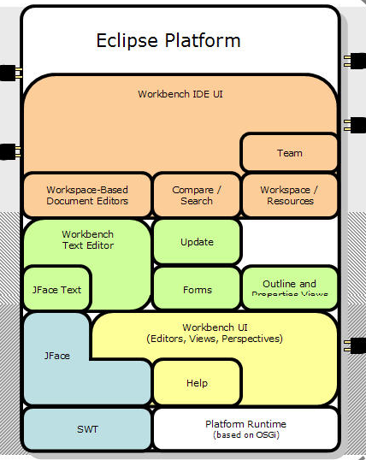
OpenModelica MDT – Eclipse Plugin
Browsing of packages, classes, functions
Automatic building of executables;
separate compilation
Syntax highlighting
Code completion,
Code query support for developers
Automatic Indentation
Debugger
(Prel. version for algorithmic subset)

Slide 3
Outline
Eclipse and Exercise Setup
All Exercises
  00_simplesim
  01_experiment
  02a_exp1, 02b_exp2
  03_symbolicderivative
  04_assignment
  05a_assigntwotype
  05b_modassigntwotype
  06_advanced
  07_OMCAndCorba
  08-11 – as samples of Prog. Lang. modeling

Slide 4
Selected Exercises in this Course
  00_simplesim
  01_experiment
  02a_exp1, (02b_exp2 optional)
  03_symbolicderivative
  04_assignment (optional)

Slide 5
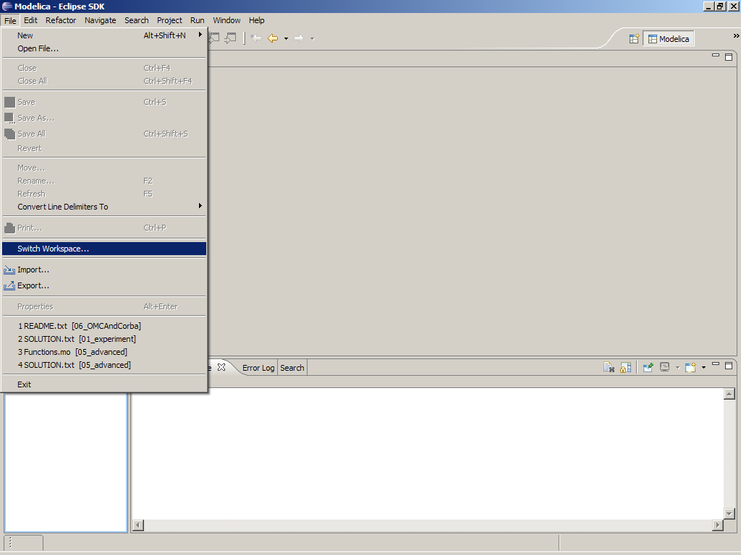
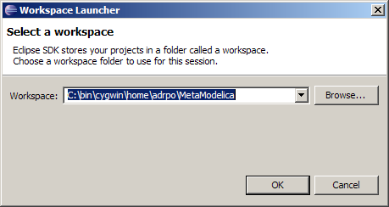
Eclipse Setup – Switching Workspace
Use a clean workspace
We need to import many projects

Slide 6
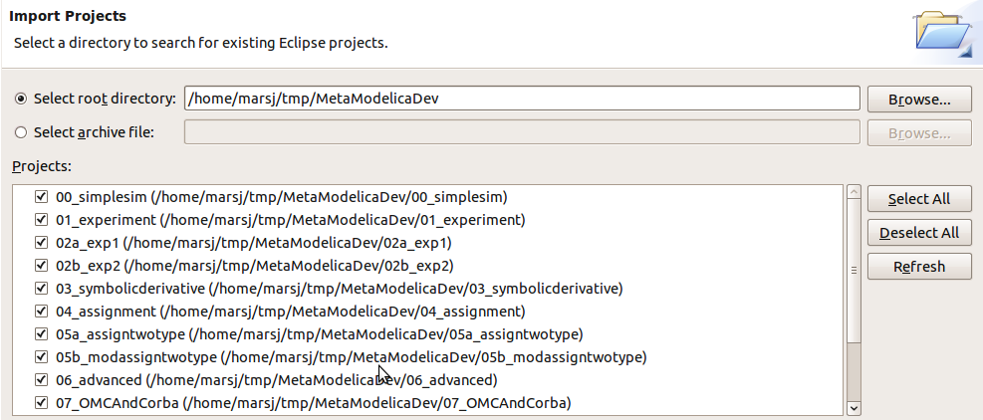
Import Projects
File → Import
  General → Existing projects into workspace

Slide 7
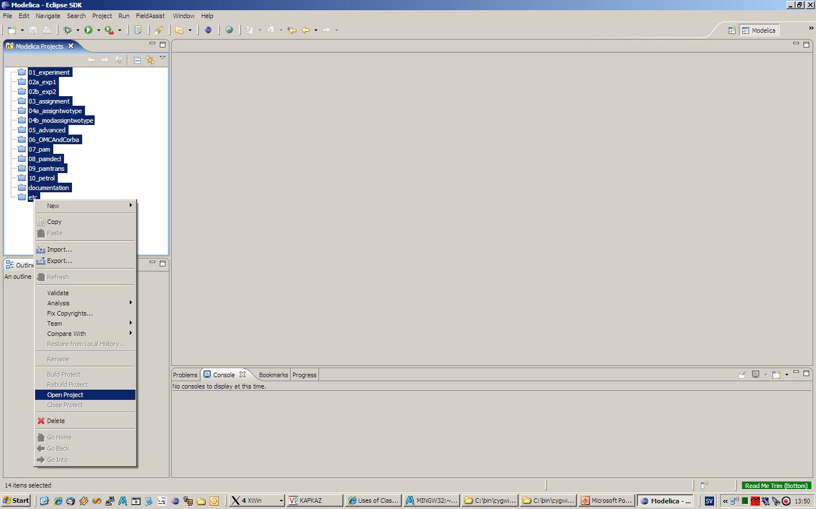
Select and Open all projects

Slide 8
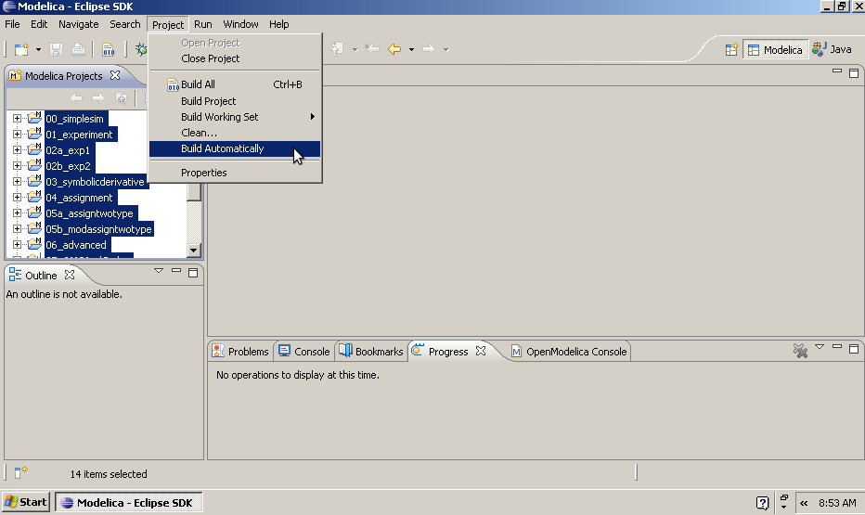
Don't build projects automatically

Slide 9
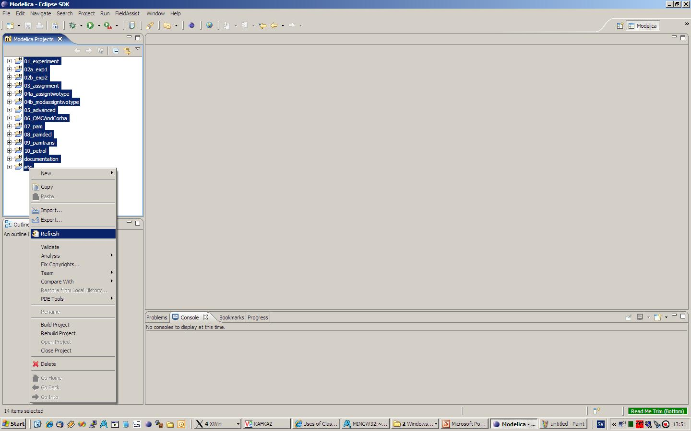
Refresh all projects

Slide 10
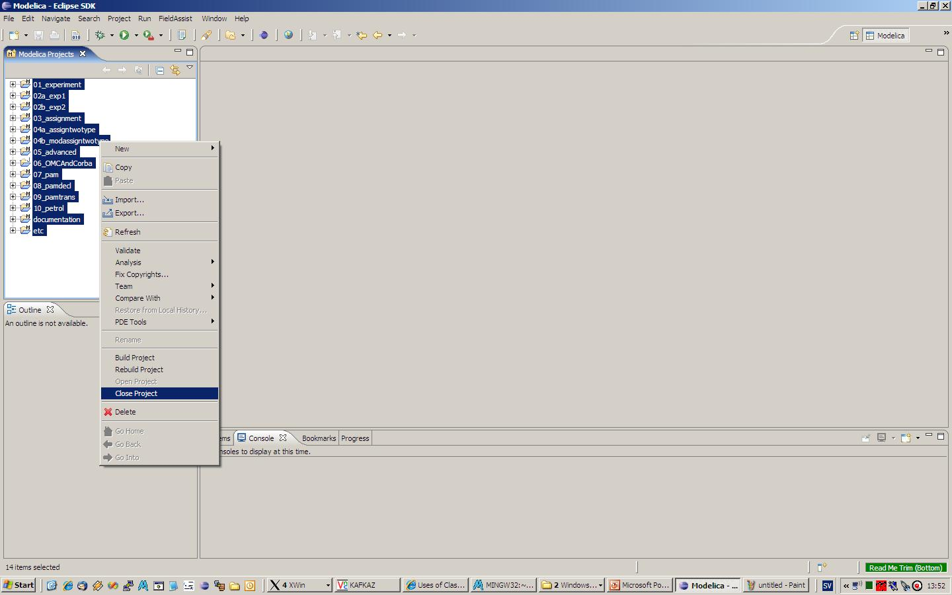
Close all projects

Slide 11
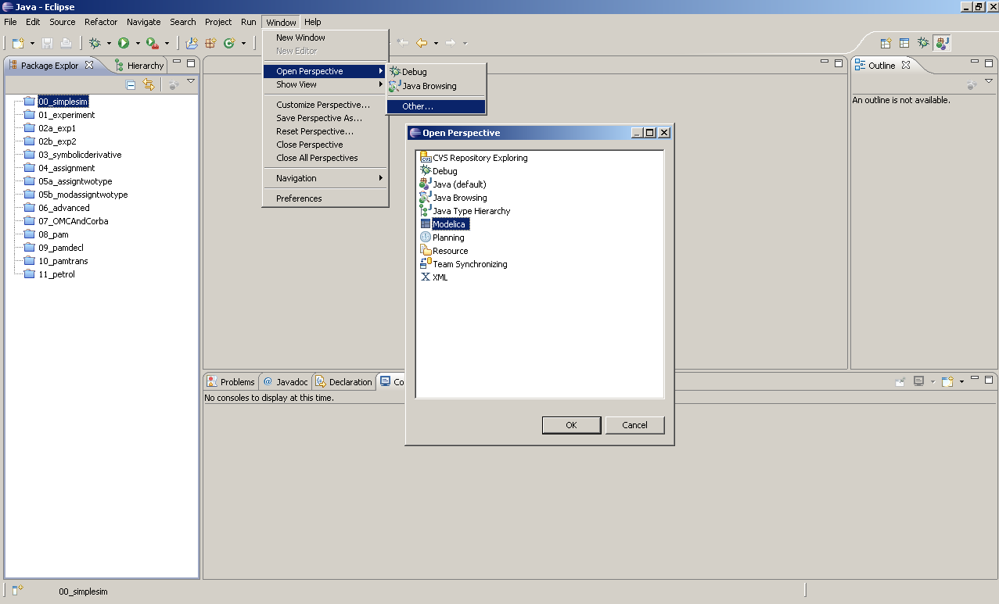
Switch to Modelica Perspective

Slide 12
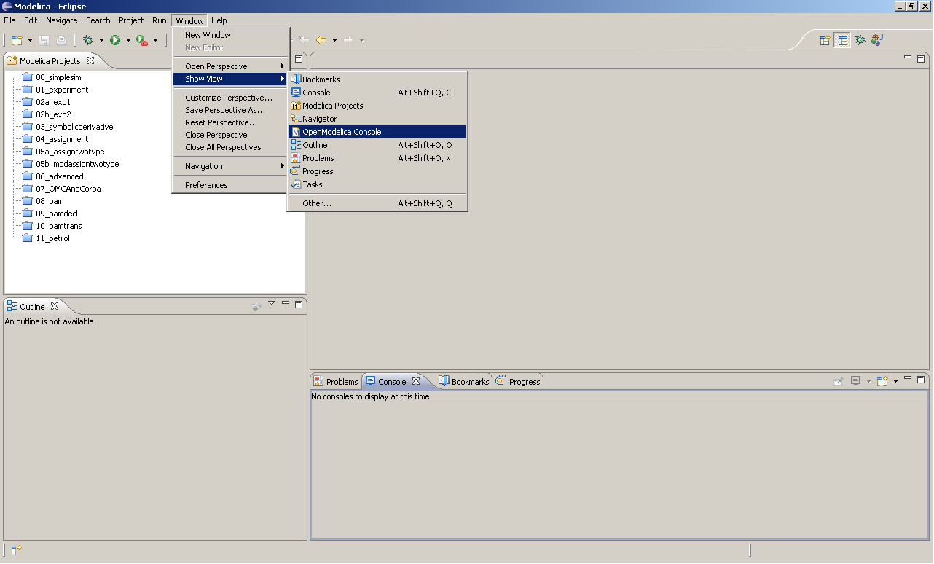
Show the OpenModelica Console View

Slide 13
Exercises - 00_simplesim
See README.txt in the Eclipse project
In this exercise you perform a simple simulation in the MDT Eclipse environment
Assignment
  Type or copy a simple model into an Eclipse project
  Open the Eclipse view “OpenModelica console”
  simulate with the simulate command
  plot with the plot command.
Note: In the following exercises you will no longer use the “OpenModelica console”

Slide 14
Exercises 01 - 04
  01_experiment
  02a_exp1, (02b_exp2 optional)
  03_symbolicderivative
  04_assignment (optional)

Slide 15
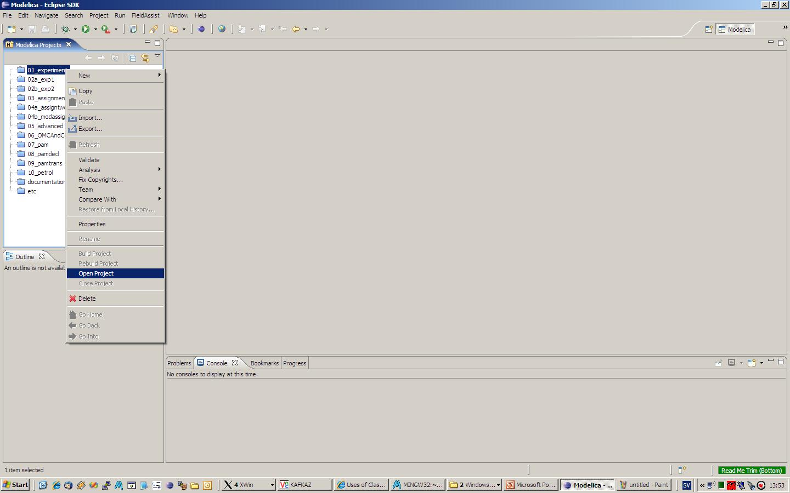
Open the first project

Slide 16
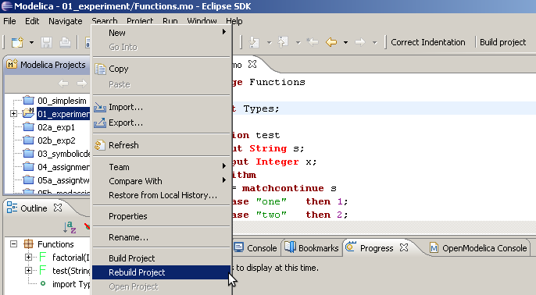
Build the first project
Always use Rebuild Project or the button
(Build Project only works if you modify a source file)
After having pressed the button once, Alt+B can be used

Slide 17
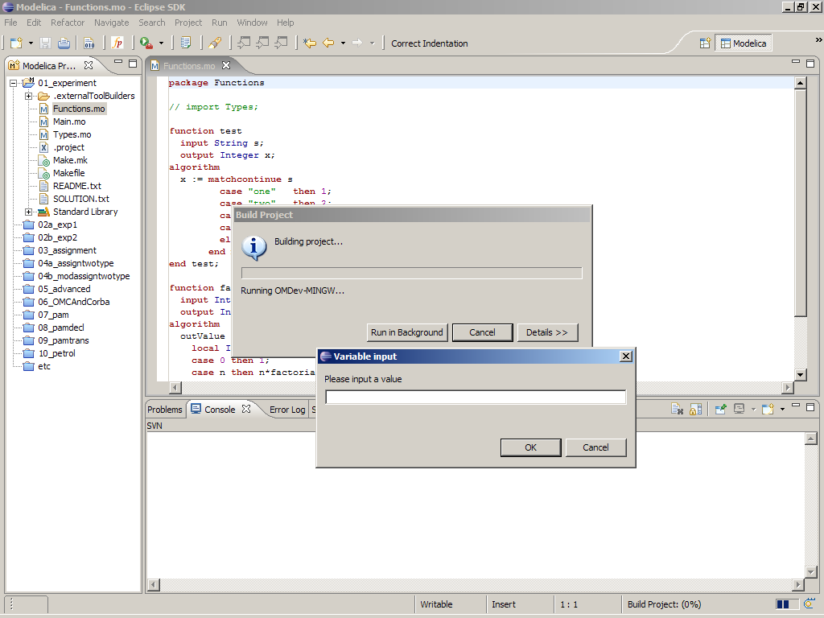
Eclipse – Building a project
clean – cleans the project
run – runs the program
syntax problems are updated
on save in the problems view.
the build and run results
are displayed in the console

Slide 18
OMC Debugging
00_simplesim
01_experiment
02a_exp1, (02b_exp2 optional)
03_symbolicderivative
04_assignment (optional)

Slide 19
Debugging using OMC
Not yet available
Debug data structures using printAny(data)
You can also switch to RML for an algorithmic debugger

Slide 20
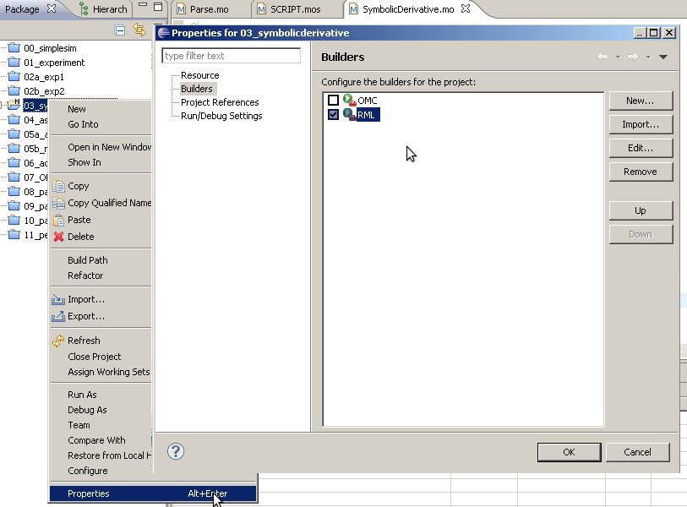
Changing compiler to RML

Slide 21
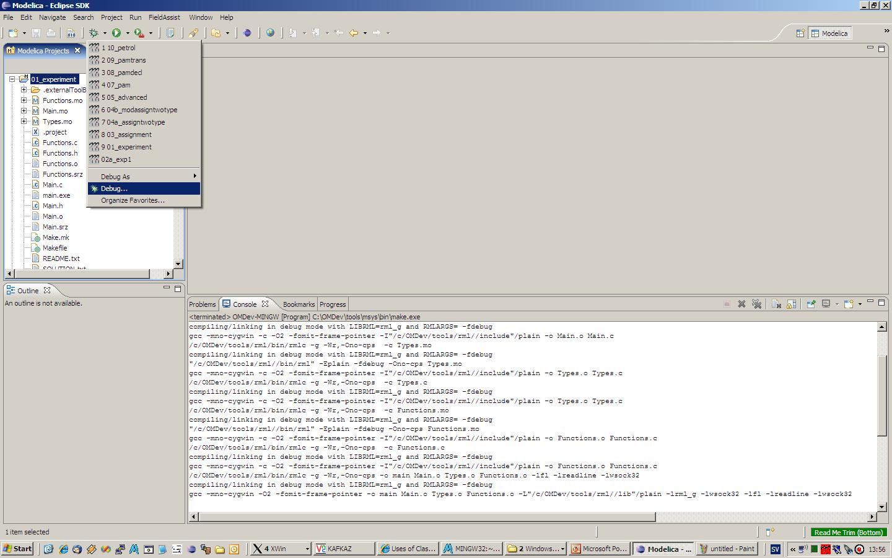
Setting the debug configuration (RML only)

Slide 22
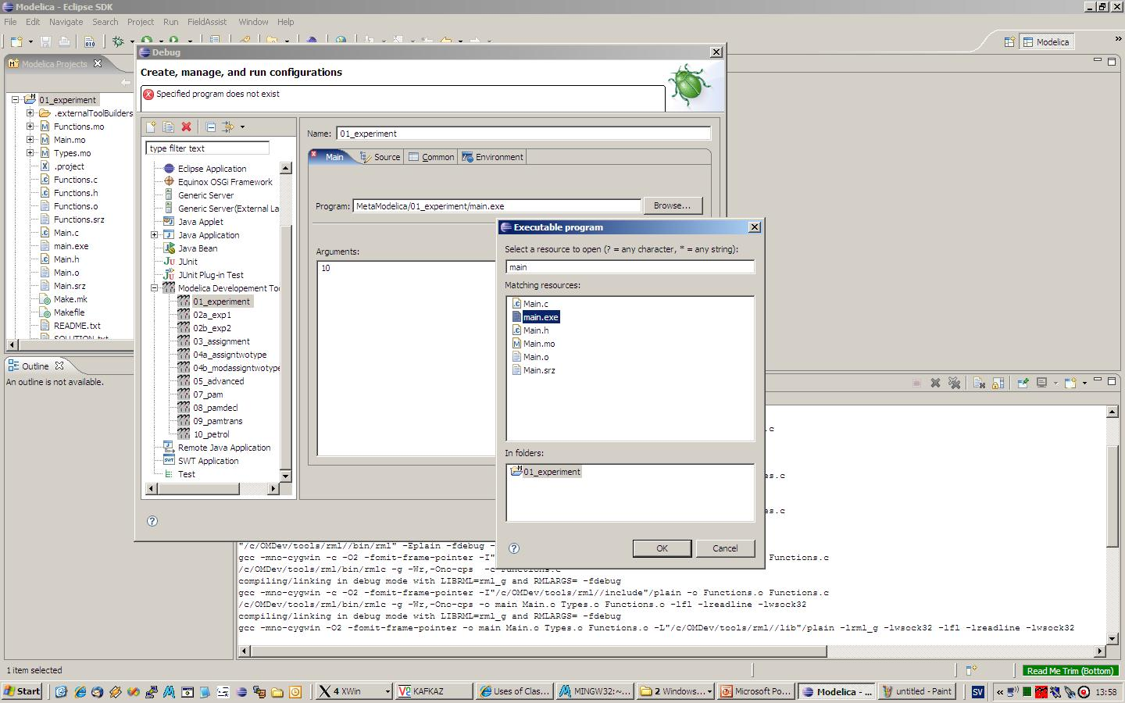
Specify the name of the executable
Click Browse and select the executable you just built.

Slide 23
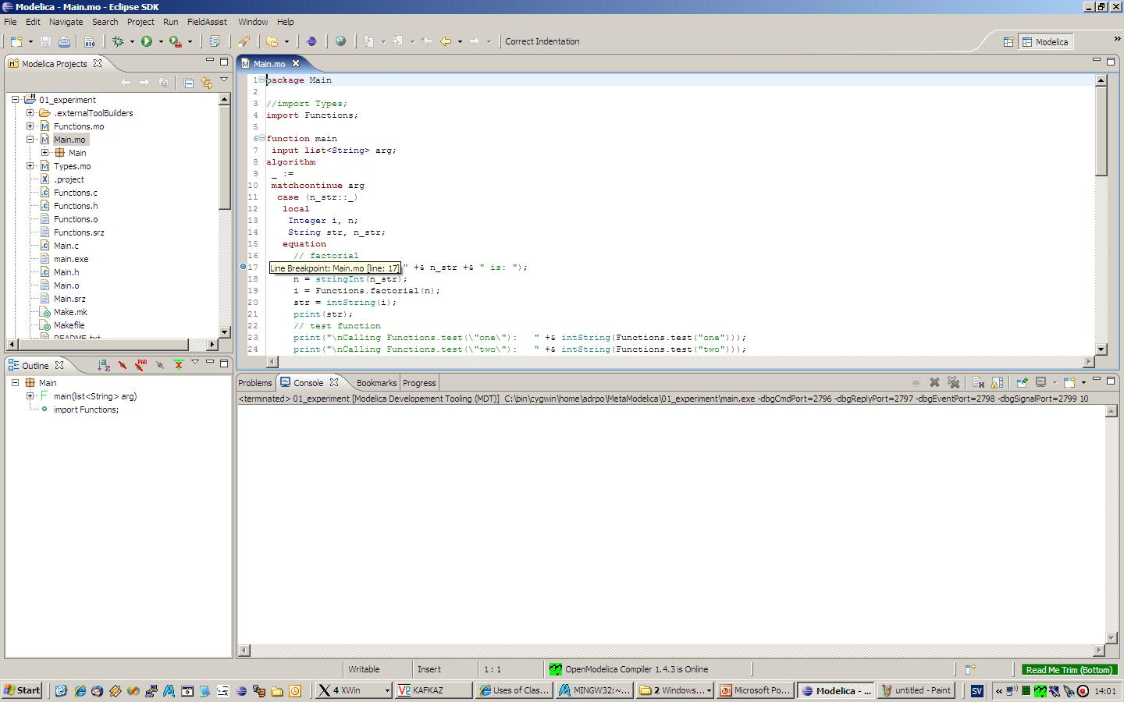
Set breakpoints in .mo file
Double click on the ruler to set breakpoints

Slide 24
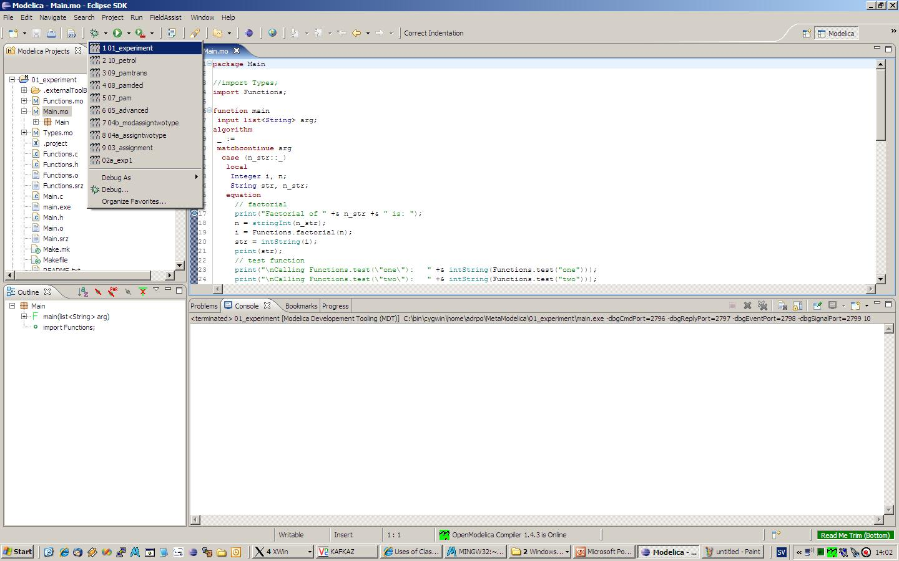
Run the debug configuration to start debugging
Click and select the
debug configuration.
The debugging will start.

Slide 25
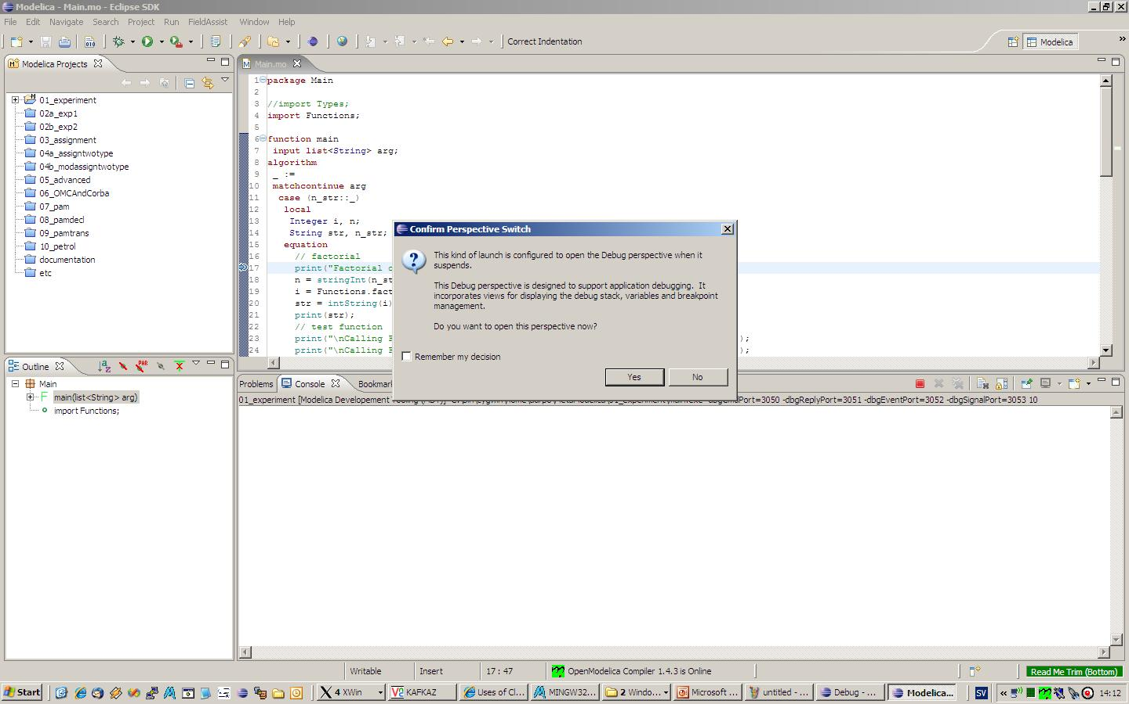
Eclipse will ask to switch to debugging perspective

Slide 26
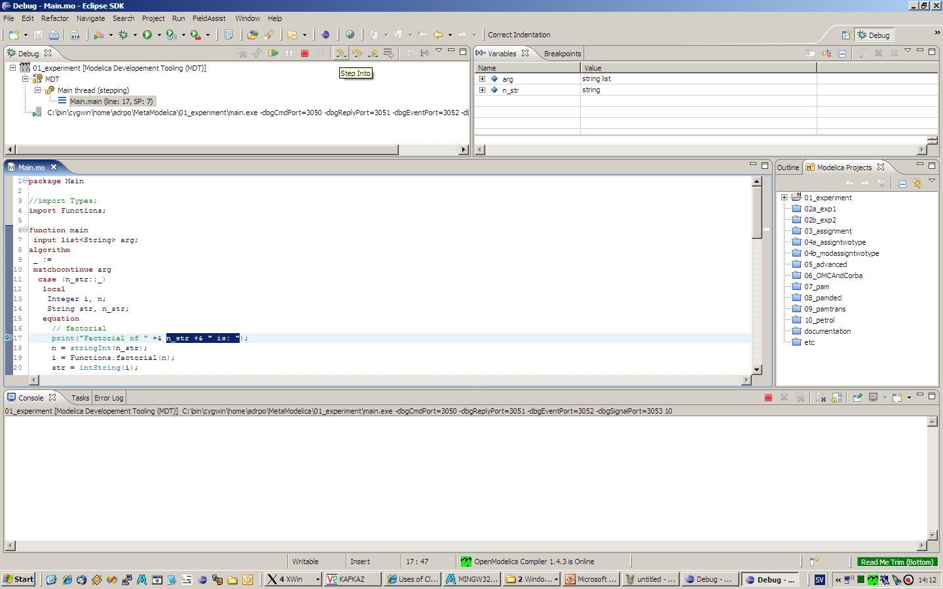
Debugging perspective
Browse variables here.
Also there is a tab with breakpoints.
Use the buttons to step.
Only step into works right now.

Slide 27
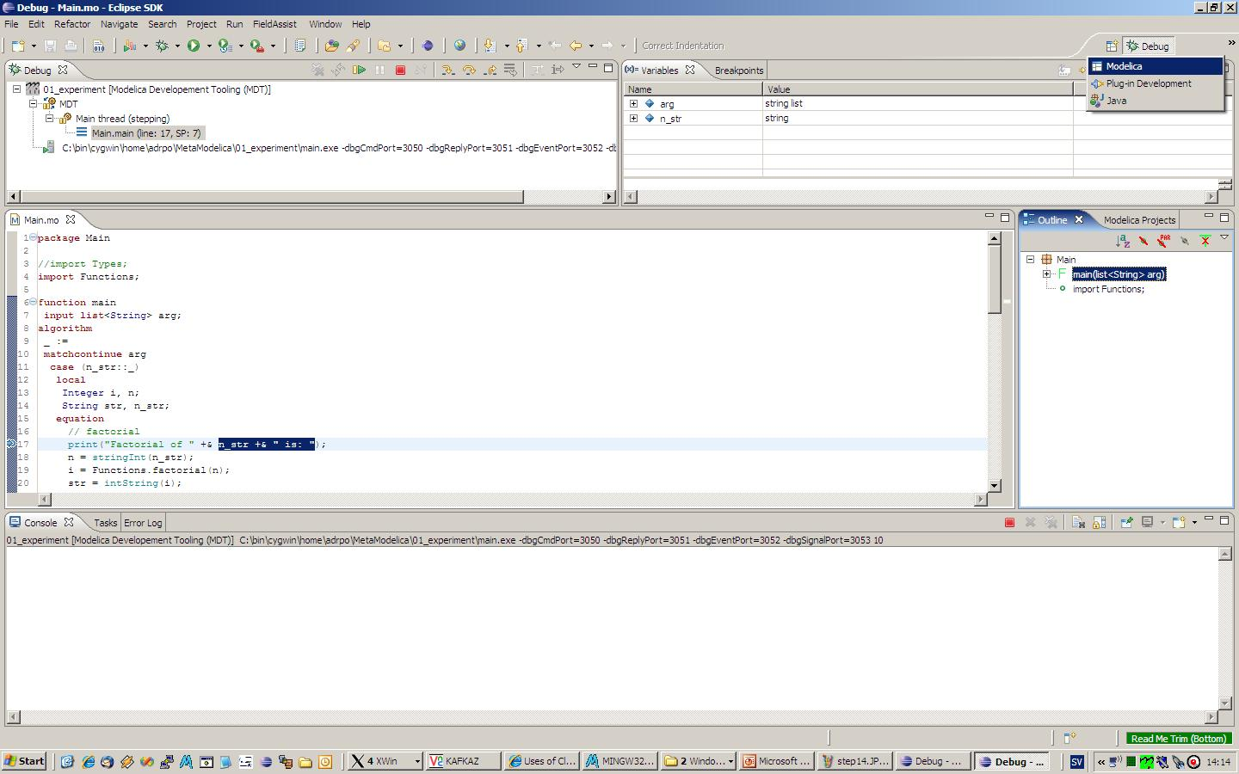
Switching perspectives
Switch between Debug and Modelica Perspective

Slide 28
Eclipse Setup – Creating the projects
repeat the procedure for all exercises
  01_experiment
  02a_exp1, 02b_exp2
  03_symbolicderivative
  04_assignment
  05a_assigntwotype
  05b_modassigntwotype
  06_advanced
  07_OMCAndCorba
leave open only the project you are working on! close all the others

Slide 29
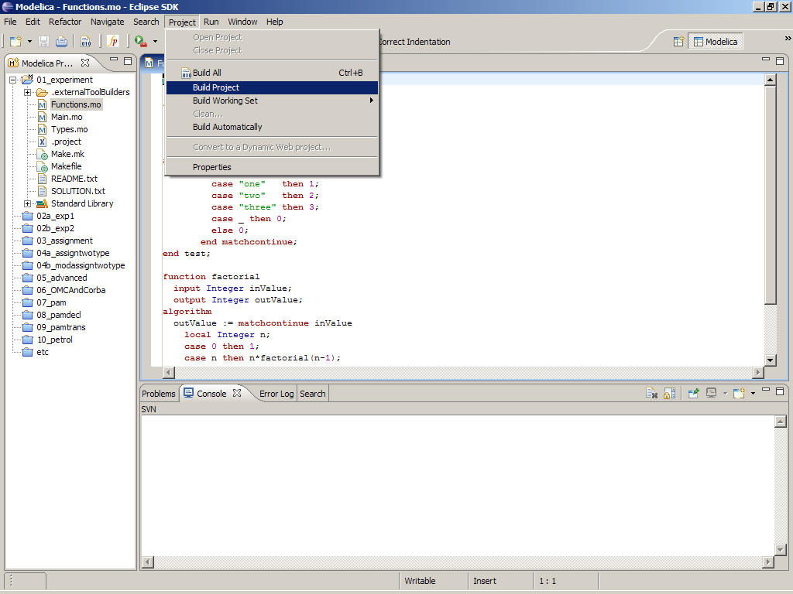
Eclipse – Building a project

Slide 30
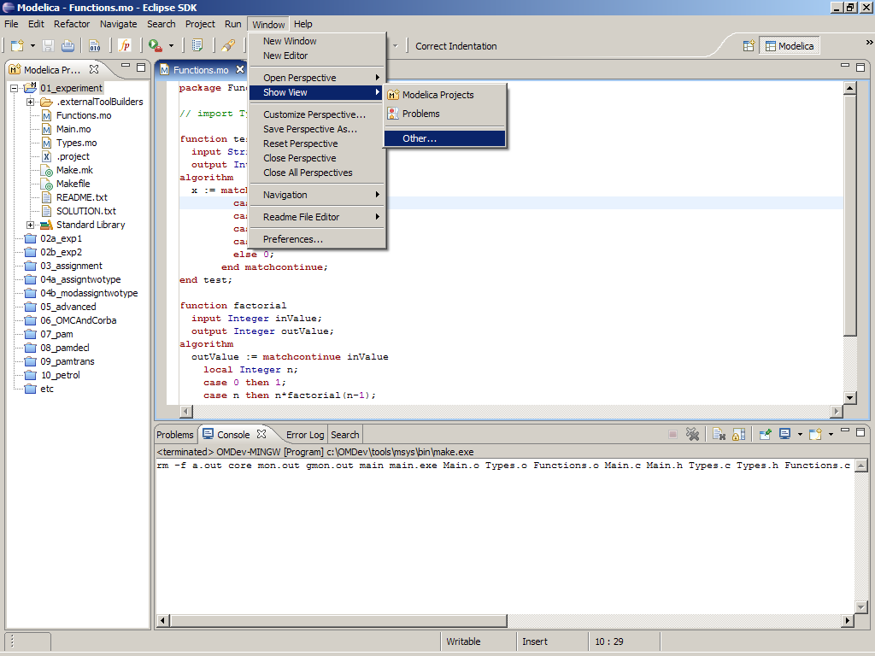
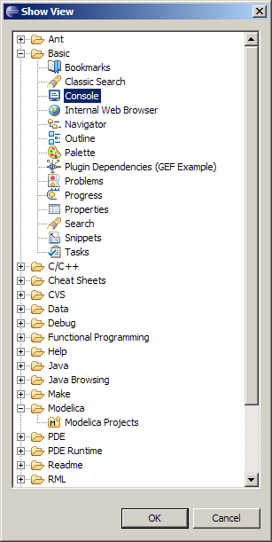
Eclipse – Opening views
To open additional views:
Window->ShowView->Other

Slide 31
Exercises
Each exercise is in a different Eclipse project
All exercises have :
  README.txt - information about the exercise
  SOLUTION.txt – the solution of the exercise (if the exercise has some implementation assignment)
  program.txt – input program to the exercise, edit if needed (for the exercises which have an input)
Consult the MetaModelica Programming Guide and the slides if you need additional information during the exercises.
Of course, feel free to ask us any type of questions, it is faster and better!

Slide 32
Exercises - 01_experiment
See README.txt in the Eclipse project
In this exercise you experiment with
  Types
  Constants
  Functions
Assignment
  Write functions in Functions.mo to display the constants defined in Types.mo.
  Search for // your code here in Main.mo and Functions.mo
Compare your solution with the SOLUTION.txt you find in the Eclipse project

Slide 33
Exercises – 02a_exp1
See README.txt in the Eclipse project
In this exercise you will add new constructs to the exp1 language and deal with their evaluation.
Assignment - add new constructs to the language
  a power operator (^)
  a factorial operator (!)
  search for // your code here within Exp1.mo
Note
  The parser/lexer are ready, but give parser errors for the new operators until they are added in Exp1.mo
Compare your solution with the SOLUTION.txt you find in the Eclipse project

Slide 34
Exercises – 02b_exp2
See README.txt in the Eclipse project
In this exercise you will explore a different way to model the exp1 language using different Exp trees.
Explore the Exp2.mo file and compare it with Exp1.mo file.

Slide 35
Exercises – 03_symbolicderivative
See README.txt in the Eclipse project
Assignment:
  add rules to derive ‘-’, ‘*’, sine, cosine and power expressions
  add rules to simplify ‘-’, sine, cosine and power expressions
  search for // your code here within SymbolicDerivative.mo
Compare your solution with the SOLUTION.txt you find in the Eclipse project

Slide 36
Exercises – 04_assignment
See README.txt in the Eclipse project
Assignment - add functions to print:
  the assignments present in the current program before the actual evaluation
  the environment after it was augmented with the assignments
  search for // your code here within Assignment.mo
Compare your solution with the SOLUTION.txt you find in the Eclipse project

Slide 37
Exercises – 05a_assigntwotype
See README.txt in the Eclipse project
Assignment - add functions to print:
  add a new String type which can hold only integers as strings to the current Exp node
  add cases to evaluate expressions/assignments of the form "2" + 1 + "1" + 1.0 in the eval function
  search for // your code here within AssignTwoType.mo
Compare your solution with the SOLUTION.txt you find in the Eclipse project

Slide 38
Exercises – 05b_modassigntwotype
See README.txt in the Eclipse project
In this exercise you will explore a different way to structure your code within different packages.
The code from 05a_assigntwotype is now split over 4 packages.
Compare the 05a/b projects.

Slide 39
Exercises – 06_advanced (I)
See README.txt in the Eclipse project
In this exercise you experiment with
  polymorphic types
  constants
  higher order functions
Assignment 1
  Write a polymorphic function that orders a list of any type.
  The function has as input a list and a compare function between the objects of that list.
  Write the comparison functions for Integers, Strings and Reals.
  Test your function on the Types.intList

Slide 40
Exercises – 06_advanced (II)
See README.txt in the Eclipse project
Assignment 2
  Write a polymorphic map function that applies a function over a list and returns a new list with the result.
  Write three functions that transform from:
    integer to real
    integer to string
    real to string
  Use your map function and the two transformation functions to transform the Types.intList to a list of reals and a list of string, then apply the ordering function from Assignment 1 on the newly created lists

Slide 41
Exercises – 06_advanced (III)
See README.txt in the Eclipse project
Assignment 3
  Write a polymorphic map function that applies a print function over a list (of Strings) and prints the it.
  Use the transformer functions from real->string and integer->string from Assignment 2 to transform the real list or the integer list to a string list for printing.
Compare your solution with the SOLUTION.txt you find in the Eclipse project

Slide 42
OMC Overview
We are Switching to OMC Overview now!

Slide 43
OpenModelica Development Toolkit (OMDev)
OMDev is a pre-packaged pre-compiled kit containing all tools needed for OpenModelica development.
  Just unpack and set some environment variables. (Windows)
  apt-get build-dep openmodelica (Ubuntu/Debian Linux)
MetaModelica Compiler (MMC) – for developing OMC
OpenModelica Compiler (OMC) – for browsing support
Eclipse plugin MDT – (Modelica Development Tooling), e.g. for compiler (OMC) development
Pre-compiled Corba (MICO or omniORB) for tool communication
Packaged Gnu compiler (GCC; Mingw version for Windows)
Emacs mode
Online (web) Subversion for version handling
Online (web) Codebeamer for bug reporting and management
Automatic regression testing using a test suite
Unit testing using the bootstrapped OpenModelica Compiler
Interactive MetaModelica debugger

Slide 44
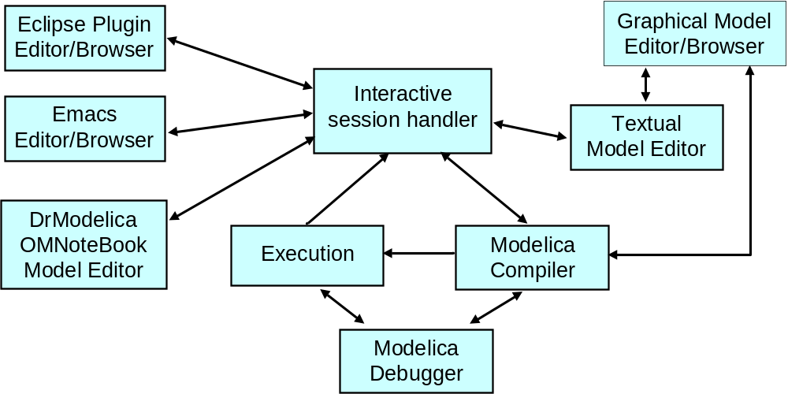
OpenModelica Environment Architecture

Slide 45
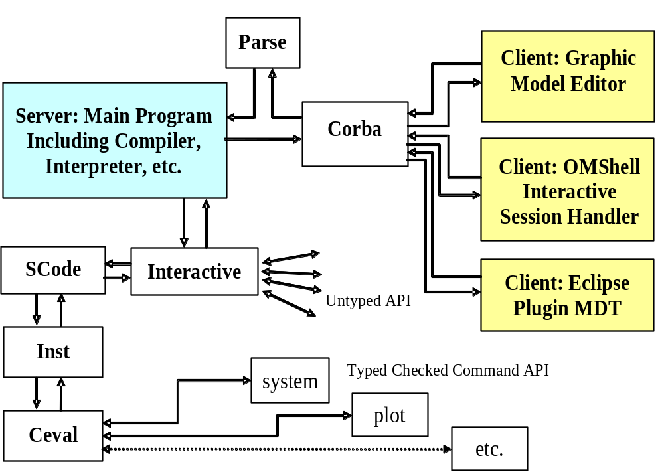
OpenModelica Client-Server Architecture

Slide 46
Released in OpenModelica 1.5.0
OpenModelica Compiler/Interpreter – OMC
Interactive session handler – OMShell
OpenModelica Notebook with DrModelica and DrControl – OMNotebook
OpenModelica Eclipse plugin MDT
SimForge graphic editor
MetaModelica Debugger

Slide 47
OpenModelica Compiler/Interpreter
OpenModelica 1.5.1
Currently implemented in 280 000 lines of MetaModelica (1.4.5 was 180 000)
Includes code generation, BLT-transformation, index reduction, connection to DASSL, etc.
Most of the Modelica 3.1 language including classes, functions, inheritance, modifications, import, etc.
Hybrid/Discrete event support

Slide 48
Corba Client-Server API
Simple text-based (string) communication in Modelica Syntax
API supporting model structure query and update
Example Calls:
Calls fulfill the normal Modelica function call syntax.:
saveModel("MyResistorFile.mo",MyResistor)
will save the model MyResistor into the file “MyResistorFile.mo”.
For creating new models it is most practical to send a model, e.g.:
model Foo end Foo;
or, e.g.,
connector Port end Port;

Slide 49
Some of the Corba API functions
saveModel(A1<string>,A2<cref>) | Saves the model (A2) in a file given by a string (A1). This call is also in typed API.
loadFile(A1<string>) | Loads all models in the file. Also in typed API. Returns list of names of top level classes in the loaded files.
loadModel(A1<cref>) | Loads the model (A1) by looking up the correct file to load in $MODELICAPATH. Loads all models in that file into the symbol table.
deleteClass(A1<cref>) | Deletes the class from the symbol table.
addComponent(A1<ident>,A2<cref>, A3<cref>,annotate=<expr>) | Adds a component with name (A1), type (A2), and class (A3) as arguments. Optional annotations are given with the named argument annotate.
deleteComponent(A1<ident>, A2<cref>) | Deletes a component (A1) within a class (A2).
updateComponent(A1<ident>, A2<cref>, A3<cref>,annotate=<expr>) | Updates an already existing component with name (A1), type (A2), and class (A3) as arguments. Optional annotations are given with the named argument annotate.
addClassAnnotation(A1<cref>, annotate=<expr>) | Adds annotation given by A2( in the form annotate= classmod(...)) to the model definition referenced by A1. Should be used to add Icon Diagram and Documentation annotations.
getComponents(A1<cref>) | Returns a list of the component declarations within class A1: {{Atype,varidA,”commentA”},{Btype,varidB,”commentB”}, {...}}
getComponentAnnotations(A1<cref>) | Returns a list {...} of all annotations of all components in A1, in the same order as the components, one annotation per component.
getComponentCount(A1<cref>) | Returns the number (as a string) of components in a class, e.g return “2” if there are 2 components.
getNthComponent(A1<cref>,A2<int>) | Returns the belonging class, component name and type name of the nth component of a class, e.g. “A.B.C,R2,Resistor”, where the first component is numbered 1.
getNthComponentAnnotation( A1<cref>,A2<int>) | Returns the flattened annotation record of the nth component (A2) (the first is has no 1) within class/component A1. Consists of a comma separated string of 15 values, see Annotations in Section 2.4.4 below, e.g “false,10,30,...”
getNthComponentModification( A1<cref>,A2<int>)?? | Returns the modification of the nth component (A2) where the first has no 1) of class/component A1.
getInheritanceCount(A1<cref>) | Returns the number (as a string) of inherited classes of a class.
getNthInheritedClass(A1<cref>, A2<int>) | Returns the type name of the nth inherited class of a class. The first class has number 1.
getConnectionCount(A1<cref>) | Returns the number (as a string) of connections in the model.
getNthConnection(A1<cref>, A2<int>) | Returns the nth connection, as a comma separated pair of connectors, e.g. “R1.n,R2.p”. The first has number 1.
getNthConnectionAnnotation( A1<cref>,A2<int>) | Returns the nth connection annotation as comma separated list of values of a flattened record, see Annotations in Section 2.4.4 below.
addConnection(A1<cref>,A2<cref>, A3<cref>, annotate=<expr>) | Adds connection connect(A1,A2) to model A3, with annotation given by the named argument annotate.
updateConnection(A1<cref>, A2<cref>,A3<cref>, annotate=<expr>) | Updates an already existing connection.
deleteConnection(A1<cref>, A2<cref>,A3<cref>) | Deletes the connection connect(A1,A2) in class given by A3.
addEquation(A1<cref>,A2<expr>, A3<expr>)(NotYetImplemented) | Adds the equation A2=A3 to the model named by A1.
getEquationCount(A1<cref>) (NotYetImplemented) | Returns the number of equations (as a string) in the model named A1. (This includes connections)
getNthEquation(A1<cref>,A2<int>) (NotYetImplemented) | Returns the nth (A2) equation of the model named by A1. e.g. “der(x)=-1” or “connect(A.b,C.a)”. The first has number 1.
deleteNthEquation(A1<cref>, A2<int>)(NotYetImplemented) | Deletes the nth (A2) equation in the model named by A1. The first has number 1.
getConnectorCount(A1<cref>) | Returns the number of connectors (as a string) of a class A1. NOTE: partial code instantiation of inheritance is performed before investigating the connector count, in order also to get the inherited connectors.
getNthConnector(A1<cref>,A2<int>) | Returns the name of the nth connector, e.g “n”. The first connector has number 1.
getNthConnectorIconAnnotation( A1<cref>,A2<int>) | Returns the nth connector icon layer annotation as comma separated list of values of a flat record, see Annotation below. NOTE: Since connectors can be inherited, a partial instantiation of the inheritance structure is performed. The first has number 1.
getNthConnectorDiagramAnnotation(A1<cref>,A2<int>) (NotYetImplemented) | Returns the nth connector diagram layer annotation as comma separated list of values of a flat record, see Annotation below. NOTE: Since connectors can be inherited, a partial instantiation of the inheritance structure is performed. The first has number 1.
getIconAnnotation(A1<cref>) | Returns the Icon Annotation of the class named by A1.
getDiagramAnnotation(A1<cref>) | Returns the Diagram annotation of the class named by A1. NOTE: Since the Diagram annotations can be found in base classes a partial code instantiation is performed that flattens the inheritance hierarchy in order to find all annotations.
getPackages(A1<cref>) | Returns the names of all Packages in a class/package named by A1 as a list, e.g.: {Electrical,Blocks,Mechanics, Constants,Math,SIunits}
getPackages() | Returns the names of all package definitions in the global scope.
getClassNames(A1<cref>) | Returns the names of all class defintions in a class/package.
getClassNames() | Returns the names of all class definitions in the global scope.
getClassRestriction(A1<cref>) | Returns the kind of restricted class of <cref>, e.g. "model", "connector", "function", "package", etc.
isType(A1<cref>) | Returns "true" if class is a type, otherwise "false".
isPrimitive(A1<cref>) | Returns "true" if class is of primitive type, otherwise "false".
isConnector(A1<cref>) | Returns "true" if class is a connector, otherwise "false".
isModel(A1<cref>) | Returns "true" if class is a model, otherwise "false".
isRecord(A1<cref>) | Returns "true" if class is a record, otherwise "false".
isBlock(A1<cref>) | Returns "true" if class is a block, otherwise "false".
isFunction(A1<cref>) | Returns "true" if class is a function, otherwise "false".
isPackage(A1<cref>) | Returns "true" if class is a package, otherwise "false".
isClass(A1<cref>) | Returns "true" if A1 is a class, otherwise "false".
isParameter(A1<cref>) | Returns "true" if A1 is a parameter, otherwise "false".
isConstant(A1<cref>) | Returns "true" if A1 is a constant, otherwise "false".
isProtected(A1<cref>) | Returns "true" if A1 is protected, otherwise "false".
existClass(A1<cref) | Returns "true" if class exists in symbolTable, otherwise "false".
existModel(A1<cref>) | Returns "true" if class exists in symbol table and has restriction model, otherwise "false".
existPackage(A1<cref>) | Returns "true" if class exists in symbol table and has restriction package, otherwise "false".

Slide 50
Platforms
All OpenModelica GUI tools (OMShell, OMNotebook, ...) are developed on the Qt4 GUI library, portable between Windows, Linux, Mac
Both compilers (OMC, MMC) are portable between the three platforms and compiled nightly
  Windows – main release platform
  Linux – main development platform
  Mac – available

Slide 51
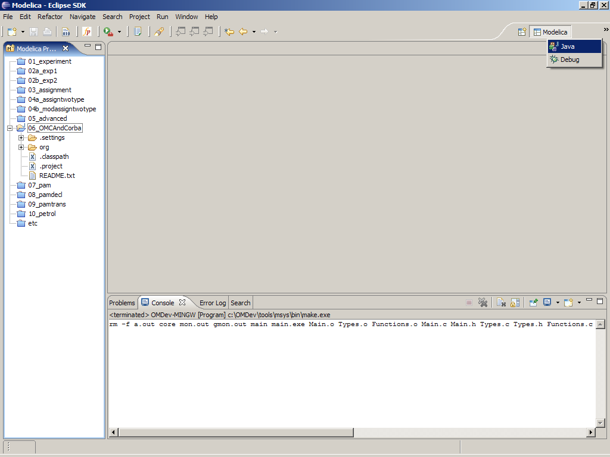
Eclipse – Switching to Java Perspective

Slide 52
Exercises – 07_OMCAndCorba
See README.txt in the Eclipse project
In this exercise you will send commands to the OMC Compiler (omc.exe) via CORBA
OMCProxy.java has functionality for
  starting the omc process if is not already started
    the starting is a bit different for Windows/Linux
  sending commands to OMC
  logging facilities
If you need clients in C++ or Python check
  http://www.ida.liu.se/labs/pelab/modelica/OpenModelica.html
  developer pages

Slide 53
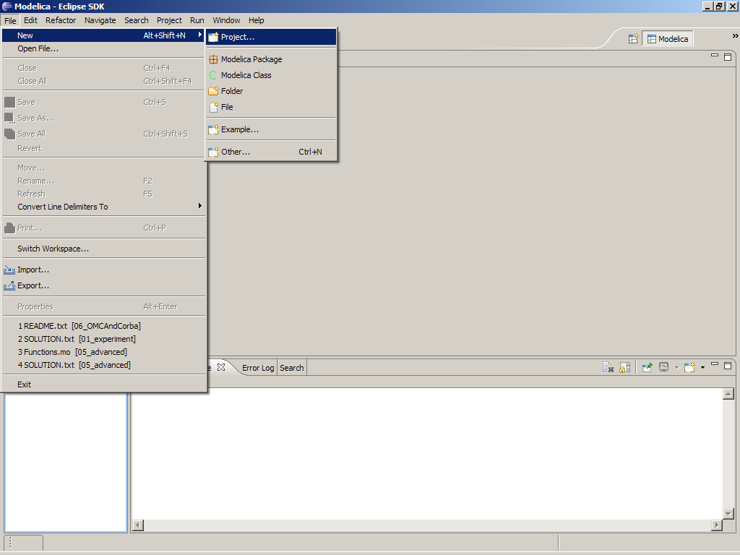
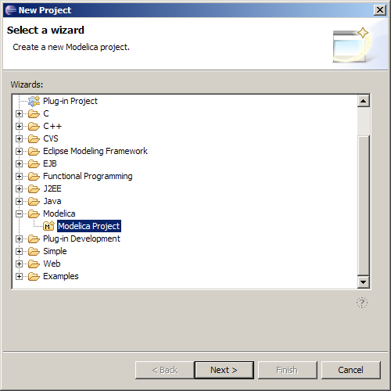
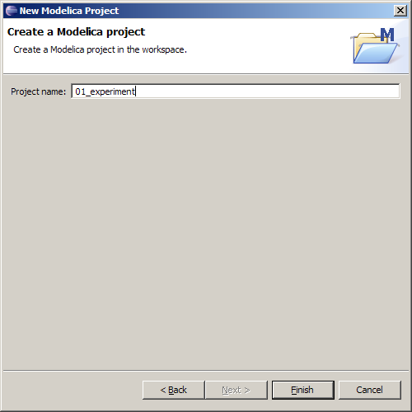
Eclipse Setup – Creating the projects

Slide 54
End
Thank you!
Administrative Question:
  What would you like to implement tomorrow
  in the OpenModelica Compiler?

